Slide 1
Alberto Food production Name Institution
Course
Date

Slide 2
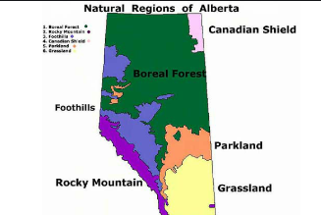
Food production in Alberto
Image
The paper address food and culture of Canada. I have chosen Alberta as my region in my cooking group. It is estimated to have a population of about 4,067,175 people and to be approximately 660,000 kilometers squared.
Introduction

Slide 3
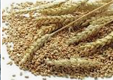
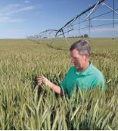
Food Production
Crops grown- are barley, wheat, fall rye and pulses.
The staple industry in this region is agriculture.
Foods made-Iconic foods are made in Alberta
Notes:
Crops grown- Alberta is well known for growing of barley, wheat, fall rye and pulses.
The staple industry in this region is agriculture. The primary crops are wheat, barley and canola. The region is dominated by strong livestock sector. People practices intensive farming with several family farms. Foods made-Iconic foods are made in Alberta These foods include: Alberta beef, Perogies, Green onion cakes, Bison, Bloody Caesar, and Ginger Beef.

Slide 4
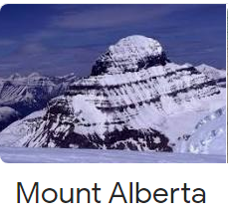
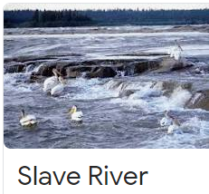

Geographical influences
Geography
Mountains
Well watered and several valleys
Rocky mountains
Rivers- Slave river
Common animals are cattle, sheep and pigs.
Notes:
In Alberta there are several mountains that in one way or the other influences agricultural production in the regions. For instance we have Mount Columbia which is around 12, 293 fts. We also have mount Alberta with the height of 11,873 fts. These mountains offers a favorable climatic conditions like temperature for growth of crops such as wheat and barley. Cattle, sheep and pigs are common animals in this region.

Slide 5
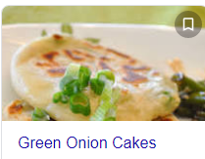
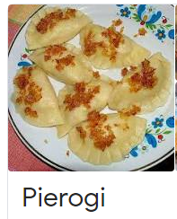
Cuisine in Alberta
Common dishes are iconic foods
These foods include:
Alberta beef,
Pierogis
Green onion cakes,
, Bloody Caesar, and
Ginger Beef
Notes:
Cuisine
Alberta is known for producing several types of foods. For instance, it produces Perogies foods such as , Bloody Caesar, Ginger beef, Green onion cakes, Alberta beef, Puffed wheat squares, Taber corn, Edmonton-style donairs and Vietnamese subs. For instance pierogi which is the one of common dishes is pan fried and its associated with European cuisine. It is made covering unleaved dough with savoury .

Slide 6
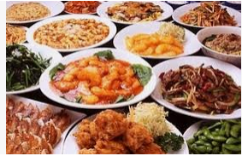
CULTURAL INFLUENCES
Chinese and Indians are immigrants in Alberta
Present immigrants in Alberta are
Mexican and
Philippines
Beef is the common type of foods
Other foods are
cucumbers, cabbage, pumpkins, corn and beets among others
Notes:
In Alberta, Chinese and Indians are some of immigrants who have recently occupied large parts of the United States of America. Recently had Mexican and Philippines coming in this region. These immigrants holds some culture. Most prepared foods especially by Chinese are deep fried like crisps textured foods. They also prepare Red-cooked pork for their families. Beef is the common type of foods in local markets. Other foods are cucumbers, cabbage, pumpkins, corn and beets among others

Slide 7
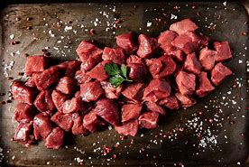
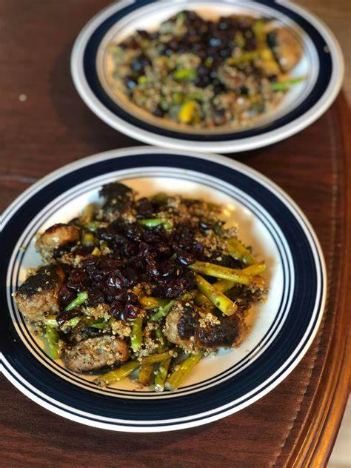
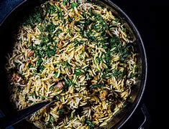
Recipe
Mutton Pilau
Ingredients:
250 gm Mutton
300 gm basmati rice
2 onions, chopped
2 potatoes, peeled, cut in 4 pieces
½ tsp cumin, turmeric powder, roasted cumin powder, butter, oil, garlic paste
Chopped coriander
Notes:
Procedure
Wash the meat and pressure cook for 25 mins with 1 tsp of garlic paste and ginger, 1tsp black pepper, salt, 1 grated tomato and onion.
When the meat is ready drain and set aside the reserve the soup. 1 cup of rice add 1 and ½ of liquid.
Heat the pan with butter and oil.
Add spices, cinnamon, cloves, pepper, cardamom, cumin.
When spices splutter in oil add onion and fry wile stirring and add tomatoes then cumin and turmeric.
Add the boiled meat and stir and taste salt and add water.
When water boils add your washed rice, add coriander and stir a little.
Heat the rice in a sealed tin till water diminishes.
When water is little, reduce heat and leave it ready to steam for 13 minutes and the food is ready to serve.
Mutton pilau is known to be originated from India. It has a cultural significance of being loved by elders to be cooked during dowry engagements. The ingredients are produced in several countries like India, Congo, Kenya and South Africa.

Slide 8
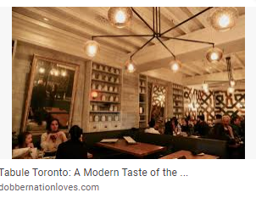
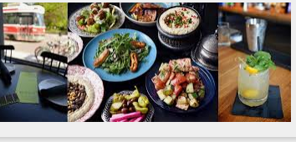
Restaurant
Tabule is a restaurant in Toronto that has Mutton Pilau.
Location
Tabule restaurant is 494 Front St. Toronto 416-583-5914 in the Canary district.
Local Restaurant
Tommy’s Kitchen is a local restaurant in my region that celebrates local cuisine.

Slide 9
References
MacLean's (2014).Who earns what: From farm to table. The average salaries of the people who bring us our food. https://www.macleans.ca/economy/money-economy/from-farm-to-table/
https://theculturetrip.com/north-america/canada/articles/10-signature-canadian-dishes-and-where-to-try-them/

